Slide 1
External Memory

Slide 2
Introduction :
The main memory is made up of semiconductor device and by nature it is volatile. For permanent storage of information we need some non volatile memory.
The memory devices need to store information permanently are termed as external memory. While working, the information will be transferred from external memory to main memory.

Slide 3
Categorizing External Memory
The devices need to store information permanently are either magnetic or optical devices.
Magnetic Devices: Optical Devices:
Magnetic disk ( Hard disk ) CD- ROM
Floopy disk CD-Recordable( CD –R)
Magnetic tape CD-R/W
DVD

Slide 4
Magnetic Disk
A disk is a circular platter constructed of metal or of plastic coated with a magnetizable material.
Data are recorded on and later retrieved from the disk via a conducting coil named the head.
During a read or write operation, the head is stationary while the platter rotates beneath it.

Slide 5
Magnetic Disk
The write mechanism is based on the fact that electricity flowing through a coil produces a magnetic field.
Pulses are sent to the head, and magnetic patterns are recorded on the surface below. The pattern depends on the positive or negative currents.
The direction of current depends on the information stored , i.e., positive current depends on the information '1' and negative current for information '0'.

Slide 6
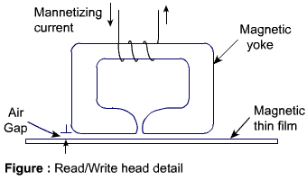
Magnetic Disk
Read/ Write head detail is shown in the figure:

Slide 7
Magnetic Disk
The head is a relatively small device capable of reading from or writing to a portion of the platter rotating beneath it.
The data on the disk are organized in a concentric set of rings, called track. Each track has the same width as the head.
Adjacent tracks are separated by gaps. This prevents error due to misalignment of the head or interference of magnetic fields.

Slide 8
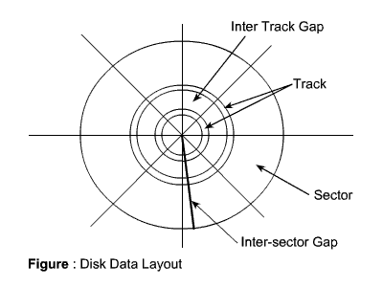
Magnetic Disk

Slide 9
Magnetic Disk
Data are transferred to and from the disk in
blocks. Usually, the block is smaller than the
capacity of the track. Accordingly, data are
stored in block-size regions known as sector.
Since data density in the outermost track is less and data density is more in inner tracks so there are wastage of space on outer tracks.

Slide 10
Magnetic Disk
To increase the capacity, the concept of zone is used instead of sectors. Each track is divided in zone of equal length and fix amount of data is stored in each zone.
So the number of zones are less in innermost track and number of zones are more in the outermost track. Therefore, more number of bits are stored in outermost track.
The disk capacity is increasing due to the use of zone, but the complexity of control circuitry is also more.

Slide 11
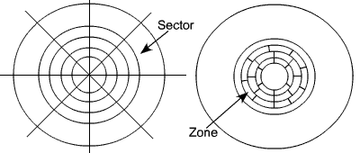
Magnetic Disk

Slide 12
Physical characteristics of disk
The head may be either fixed or movable with respect to the radial direction of the platter.
In a fixed-head disk, there is one read-write head per track. All of the heads are mounted on a rigid arm that extends across all tracks.
In a movable-head disk, there is only one read-write head. Again the head is mounted on an arm.

Slide 13
Physical characteristics of disk
Because the head must be able to be positioned above any track, the arm can be extended or retracted for this purpose.
The disk itself is mounted in a disk drive, which consists of the arm, the shaft that rotates the disk, and the electronics circuitry needed for input and output the binary data and to control the mechanism

Slide 14
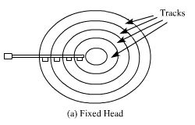
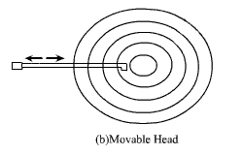
Physical organization of disk :

Slide 15
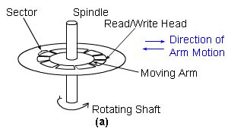
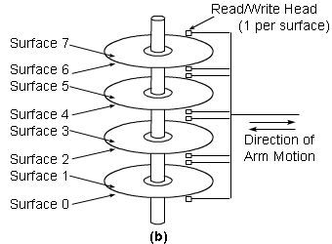
Multiple platter disk

Slide 16
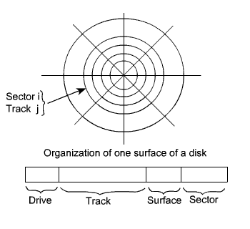
Organization and accessing of data on a disk :

Slide 17
Organization and accessing of data on a disk :
Each surface is divided into concentric tracks and each track is divided into sectors.
The set of corresponding tracks on all surfaces of a stack of disks form a logical cylinder. Data bits are stored serially on each track.
Data on disks are addressed by specifying the surface number, the track number, and the sector number.

Slide 18
Organization and accessing of data on a disk :
In most disk systems, read and write operations always start at sector boundaries.
If the number of words to be written is smaller than that required to fill a sector, the disk controller repeats the last bit of data for the remaining of the sector.

Slide 19
Organization and accessing of data on a disk :
During read and write operation, it is required to specify the starting address of the sector from where the operation will start, that is the read/write head must positioned to the correct track, sector and surface.
Therefore the address of the disk contains track no., sector no., and surface no. If more than one drive is present, then drive number must also be specified.

Slide 20
Organization and accessing of data on a disk :
The format of the disk address word is shown in the figure. It contains the drive no, track no., surface no. and sector no.
The read/write head will first positioned to the correct track. In case of fixed head system, the correct head is selected by taking the track no. from the address.
In case of movable head system, the head is moved so that it is positioned at the correct track.

Slide 21
Organization and accessing of data on a disk :
Suppose that the disk system has 8 data recording surfaces with 4096 track per surface. Tracks are divided into 256 sectors. Then the format of disk address word is:
Suppose each sector of a track contains 512 bytes of disk recorded serially, then the total capacity of the disk is:

Slide 22


Organization and accessing of data on a disk :

Slide 23
Organization and accessing of data on a disk :
For moving head system, there are two components involved in the time delay between receiving an address and the beginning of the actual data transfer.
Seek Time
Rotational Delay

Slide 24
Organization and accessing of data on a disk :
Seek Time:
Seek time is the time required to move the read/write head to the proper track.
This depends on the initial position of the head relative to the track specified in the address.

Slide 25
Organization and accessing of data on a disk :
Rotational Delay:
Rotational delay, also called the latency time is the amount of time that elapses after the head is positioned over the correct track until the starting position of the addressed sector comes under the Read/write head.

Slide 26
Disk Operation
Communication between a disk and the main memory is done through DMA.
The following information must be exchanged between the processor and the disk controller in order to specify a transfer.
Main memory address :
The address of the first main memory location of the block of words involved in the transfer.
Disk address :
The location of the sector containing the beginning of the the desired block of words.
Word count :
The number of words in the block to be transferred.

Slide 27

Disk Operation
The disk address format is:

Slide 28
Disk Operation
The word count may corresponds to fewer or more bytes than that are contained in a sector. When the data block is longer than a track:
The disk address register is incremented as successive sectors are read or written. When one track is completed then the surface count is incremented by 1.
Thus, long data blocks are laid out on cylinder surfaces as opposed to being laid out on successive tracks of a single disk surface.

Slide 29
Disk Operation
This is efficient for moving head systems, because successive sector areas of data storage on the disk can be accessed by electrically switching from one Read/Write head to the next rather than by mechanically moving the arm from track to track.
The track-to-track movement is required only at cylinder-to-cylinder boundaries.

Slide 30
Disk Performance Parameter
When a disk drive is operating, the disk is rotating at constant speed.
To read or write, the head must be positioned at the desired tack and at the beginning of the desired sector on the track.
Track selection involves moving the head in a movable-head system or electronically selecting one head on a fixed head system.

Slide 31
Disk Performance Parameter
On a movable-head system, the time taken to position the head at the track is known a seek time.
Once the track is selected, the disk controller waits until the appropriate sector rotates to line up with the head.
The time it takes to reach the beginning of the desired sector is known as rotational delay or rotational latency.

Slide 32
Disk Performance Parameter
The sum of the seek time, (for movable head system) and the rotational delay is termed as access time of the disk, the time it takes to get into appropriate position (track & sector) to read or write.
Once the head is in position, the read or write operation is then performed as the sector moves under the head, and the data transfer takes place.

Slide 33
Seek Time:
Seek time is the time required to move the disk arm to the required track. The seek time is approximated as :
Where,
estimated seek time
number of tracks traversed
constant that depends on the disk drive
startup time

Slide 34

Rotational Delay:
Disk drive generally rotates at 3600 rpm, i.e., to make one revolution it takes around 16.7 ms. Thus on the average, the rotational delay will be 8.3 ms.
The transfer time to or from the disk depends on the rotational speed of the disk and it is estimated as :

Slide 35

Rotational Delay:
Where,
T=Transfer time
b=Number of bytes to be transferred.
N=Numbers of bytes on a track
r =Rotational speed, in revolution per second.
Thus,the total average access time can be expressed as

Slide 36


